Slide 1
Coupling hydromorphology to biotic responses: challenges in assessing river restoration outcomes
Nikolai Friberg
Research Manager – Section of Freshwater Ecology
Norwegian Institute for Water Research (NIVA)
Cheney honoury fellow, water@leeds, University of Leeds

Slide 2
Lecture outline
Drivers of community composition in lotic organisms
Sensitivity of biomonitoring metrics towards HYMO change
Interaction between HYMO and other stressors
The influence of confounding variables in assessing HYMO restoration effectiveness
HYMO restorations and how they resemble natural conditions
Ways to assess HYMO restorations

Slide 3
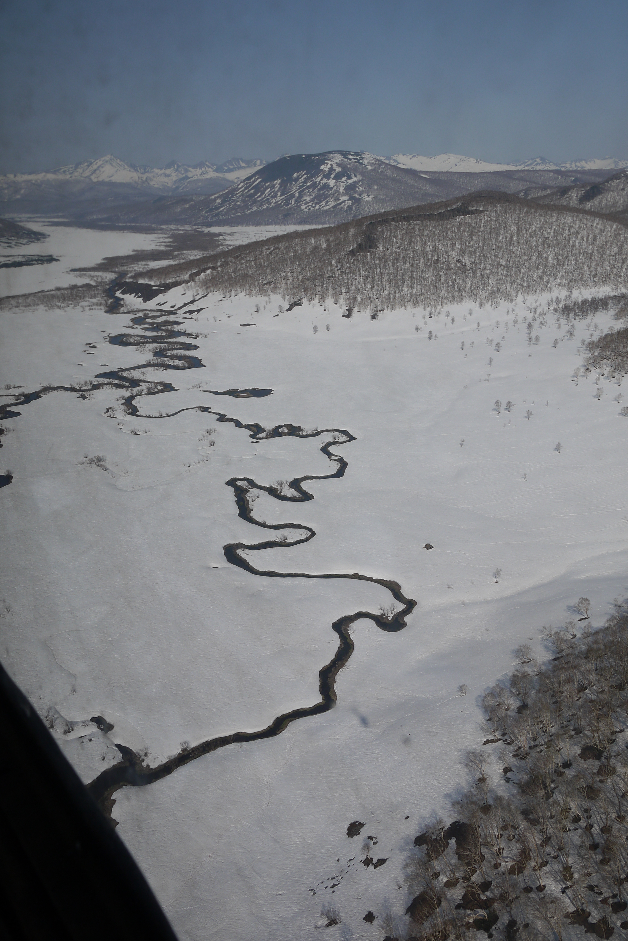
What drives community composition?
Geomorphic controls
Larger scales
Land use history
Local scales
Substrate
Current
Biotic interactions
Realised
Fundamental
Niche
Chemistry
Oxygen
Bioregion
Dispersal
Notes:
Habitat filters and biotic interactions are determining communities at local scales. However, both environmental conditions such as substrate composition and the biota are determined by larger scale processes/controls that are both spatial and temporal

Slide 4
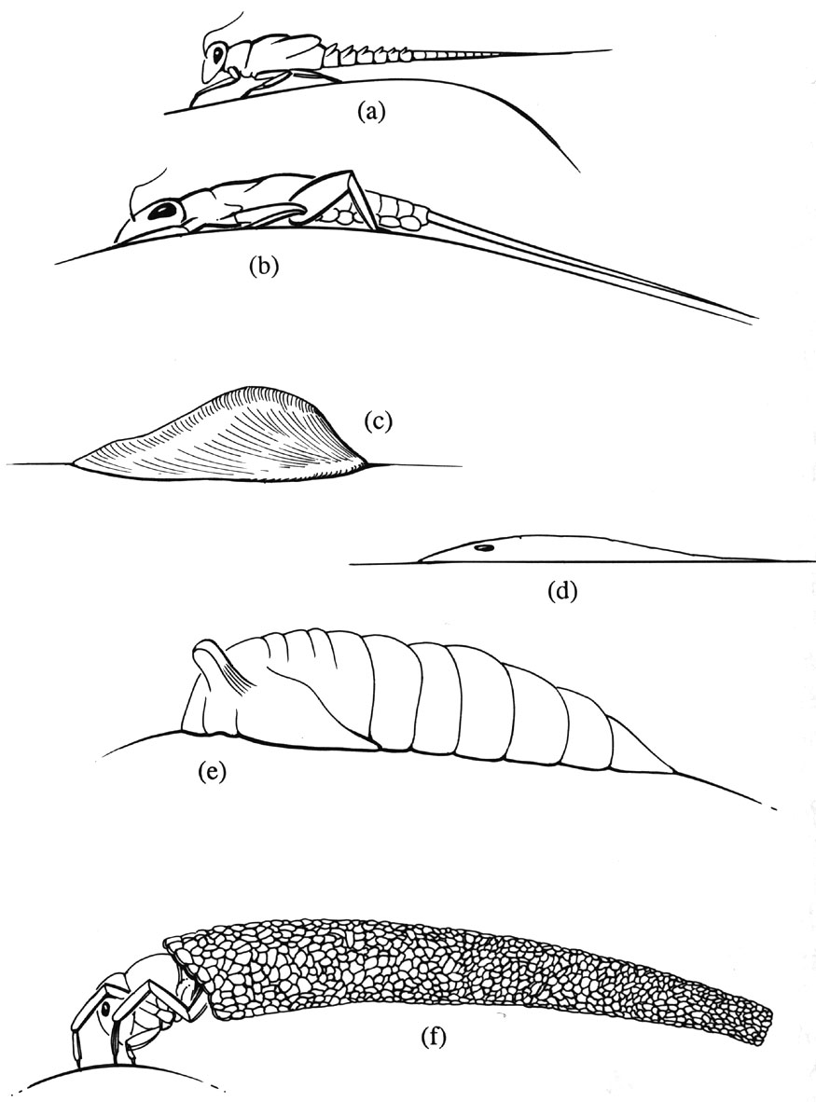
Lotic organisms
Adaptations are frequent in:
  body shape to reduce drag forces
  behavioral response to a life in flowing water
  life cycle strategies
Notes:
All stream biota show adaptations to a life in flowing water. Body shapes that reduce drag forces are common as are behavioural adaptations to avoid being flushed away by the current.

Slide 5
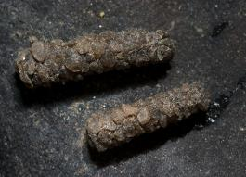
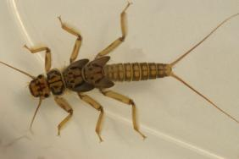
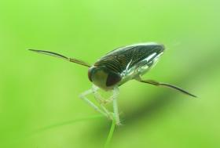
Photo:Kimberly Fleming
Photo:Friedrich Böhringer
Photo: Piet Spaans
Notes:
From the knowledge of the large array of adaptations to a life in running water shown by the stream biota and a large spatial heterogeneity of pristine lotic ecosystems we should expect a very strong link between biological communities and the HYMO environment

Slide 6
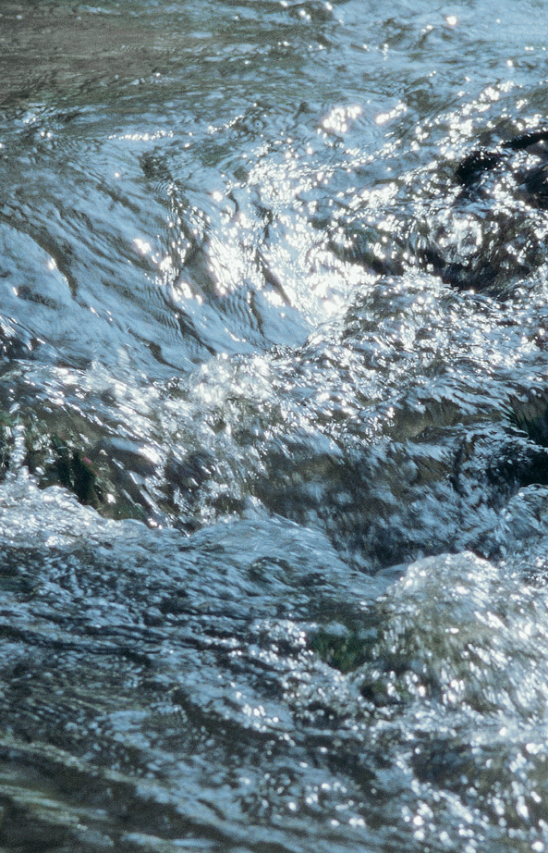
A standard metric
Morphological index ranging from completely uniform (0) to very complex (1)
Notes:
This study show the relationship between ASPT which is general degradation metric used in the UK and elsewhere and morphological index in 45 small lowland streams. HYMO was assessed very detailed at the local scale by direct measurements of e.g. current velocity and was the main stressor in all streams investigated. Despite this the relationship is not particularily strong and the slope shallow, indicating that even large differences in channel complexity have relatively limited effect on metric scores

Slide 7
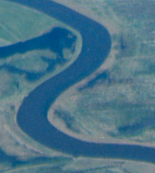
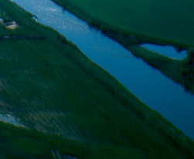
Paired comparison – BACI type design
IC Danish DSFI metric
(organic pollution)
Component part of DSFI
Without indicator weighing
Notes:
From a study with 6 streams that all had a complex (natural channel) and channelised reach adjacent to each other. If the Danish Stream Fauna Index (DSFI) was used there was a tendency for lower values in the channelised reaches but this was not significant. If just a component part of index was used that does not contain a tolerance ranking towards organic pollution the differences became significant indicating the potential of improving sensitive by reorganising existing metrics

Slide 8
Metrics sensitive to hydrological alterations
 | MESH | LIFE
Normal flow | 0.61 | 0.52
Low flow | -0.58 | -0.47
high positives = good/low negatives = bad (+1 to – 1)
Notes:
MESH is an Estonian metric to detect HYMO stress/impaired hydrology; LIFE is a metric sensitive to low flows. Both show a relatively good relationship with flow measured continiously at about 30 lowland river sites (flow statistics based on daily measurements for several years) and therefore respond as expected by yielding negative values at low flow conditons

Slide 9
Metrics sensitive to hydrological alterations vs. other stressor specific metrics
 | MESH | LIFE | ASPT (organic) | EPT (general) | SPEAR (pesticides)
Q90 | 0.61 | 0.52 | 0.59 | 0.44 | 0.6
Q10 | -0.58 | -0.47 | -0.52 | -0.43 | -0.55
high positives = good/low negatives = bad (+1 to – 1)
Notes:
Analysing the same dataset using metrics sensitve to other stressors yielded very similar results to those of the HYMO specific methods. As a consequence it is impossible diagnose what is wrong with a stream site if HYMO is an issue

Slide 10
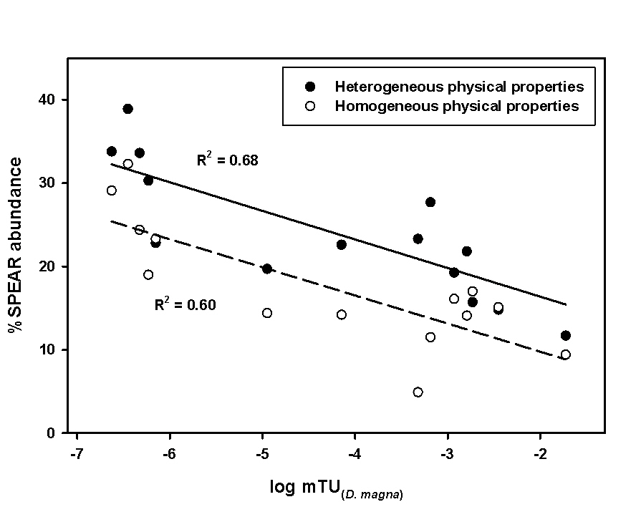
Good habitat conditions lower the effects of pesticides or?
Rasmussen et al. 2012, Environ. Poll. 164, 142-149
Notes:
Using the %SPEAR abundance which is an indicator of pesticide pollution yielded different results depending on physical complexity with the effects being less severe in the most complex reaches. Of the channel – this was independent of pesticides as the the study used a paired design where the homogeneous and heterogeneous reaches where close together and had the same pesticide pollution. The x-axis is the TU (toxicology units) calculated on the basis on measured pesticide concentrations (a range of different pesticides where found hence the normalisation into TU)

Slide 11
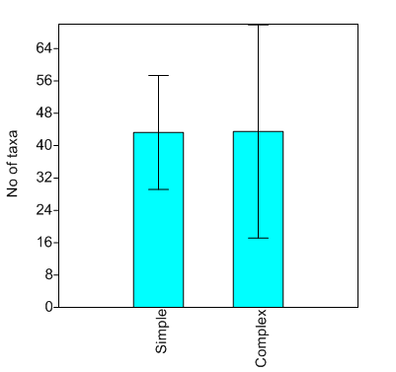
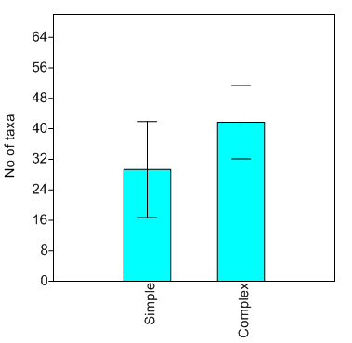
Good HYMO conditions can mitigate other effects of other stressors
Low Total P
HighTotal P
In HYMO simple and complex stream channels
(Sandin unpublished, STAR project)
Notes:
From a number of STAR sites the combined effects of Tot P and physical complexity on number of macroinvertebrate taxa was assessed. As for pesticides, good physical conditions had an mitigating effect on the P effects

Slide 12
What is the problem?
Assessment systems were developed primarily to be sensitive to water quality
  Focus on macroinvertebrates
  Sampling method
  Metrics based on primarily sensitivity towards oxygen concentration
Hydromorphology
  Measured on a different spatial scale than macroinvertebrates
  Static rather than dynamic measurements
Hydrology
  Few hydrological stations compared with biological monitoring stations and often not at the same place

Slide 13
A tendency of overreliance on the explanatory power of local environmental filters ignores:
Biotic interactions (alternative steady states)
Dispersal (meta-community theory)
Larger scales controls (temporal and spatial) on local conditions
Interaction of multiple stressors across scales

Slide 14
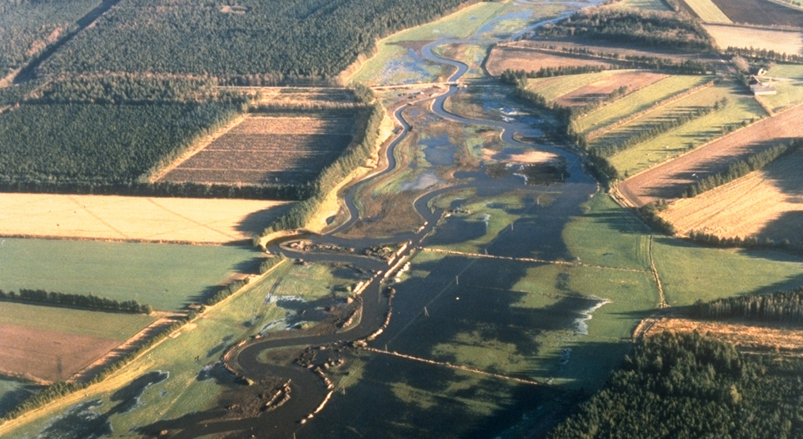
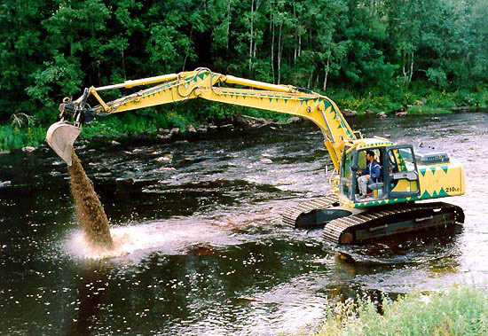
HYMO River Restoration
Spawning gravel
Remandering
Floodplain restorations
Removal of barriers

Slide 15
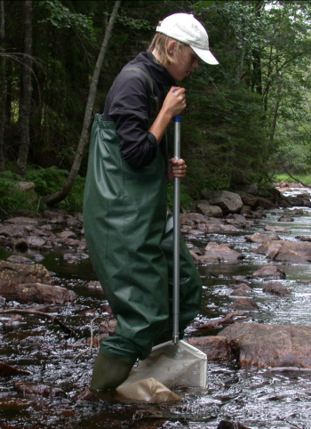

Notes:
We clearly need to think about how we assess the effects of restoration projects as the WFD compliant monitoring tools available to us might not be sufficiently precise

Slide 16
How to single out effects of HYMO degradation
Measurements of important (and detailed) features at both 1) local and 2) larger (catchment/regional) scales
Robust statistical design such as a BACI design
Control for confounding variables in both time and space

Slide 17
Even hydromorphology takes time to improve
The River Gelså was re-meandered in 1989
N=210
Gelså project – Kronvang upubl.
Notes:
From the river Gelså which is the oldest remeandering project in Denmark. When applying the Danish HYMO assessment methods 8 years and 19 years after the restoration it was evident that habitat quality was still improving > 10 years after the construction works

Slide 18
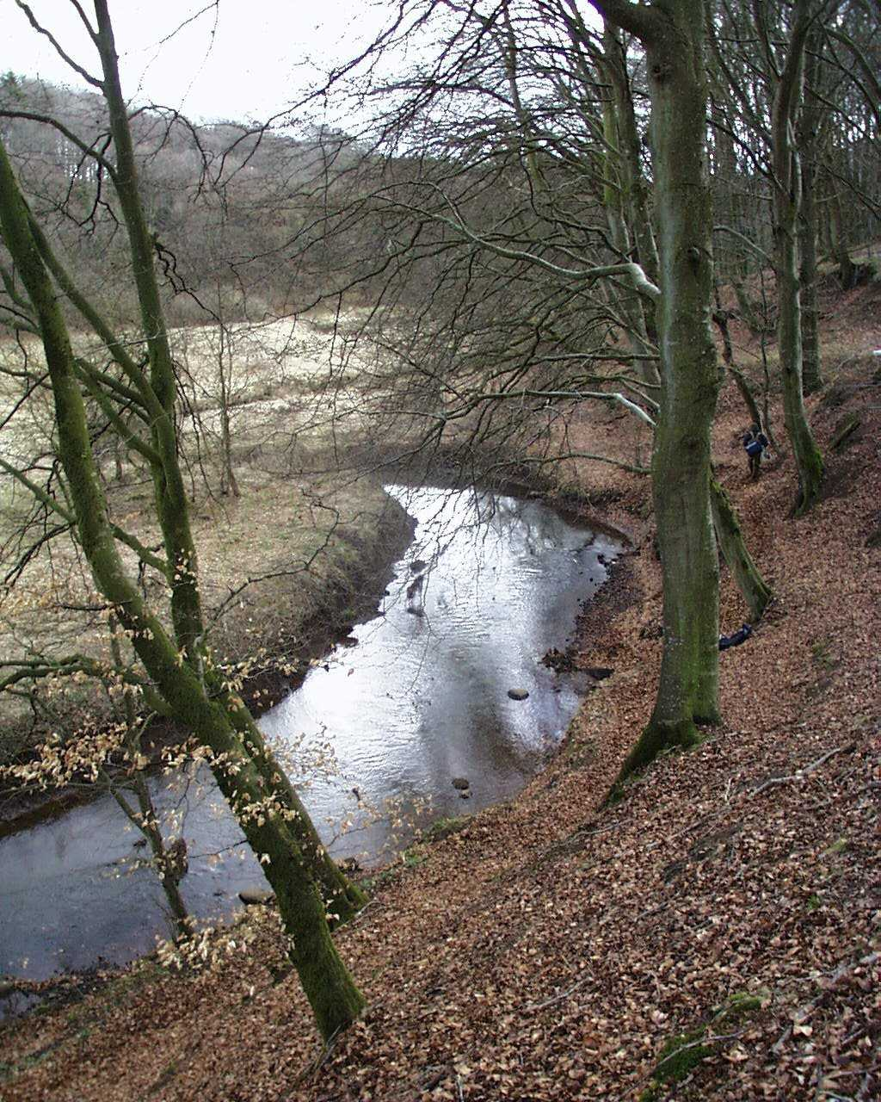
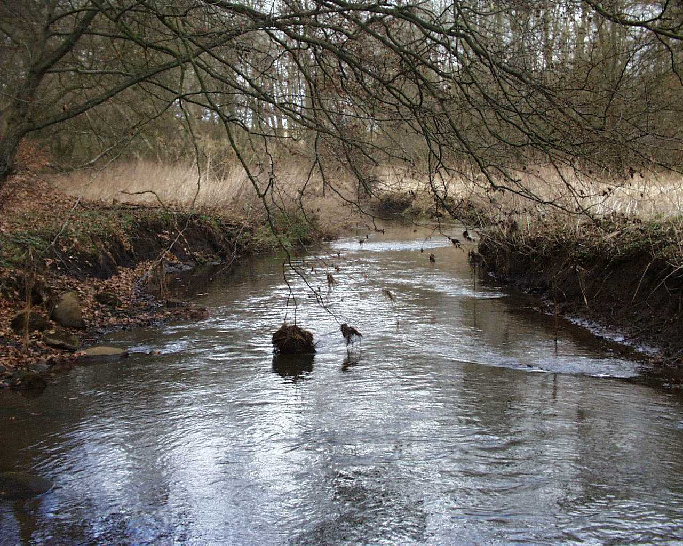
+ the unmeasured: Spatial variations in physical structure and macroinvertebrates in lowland stream riffles
Notes:
Two riffles that visually looked similar only 300 m apart were assessed in detail with regard to substrate and flow conditions and the link to the macroinvertebrate community

Slide 19
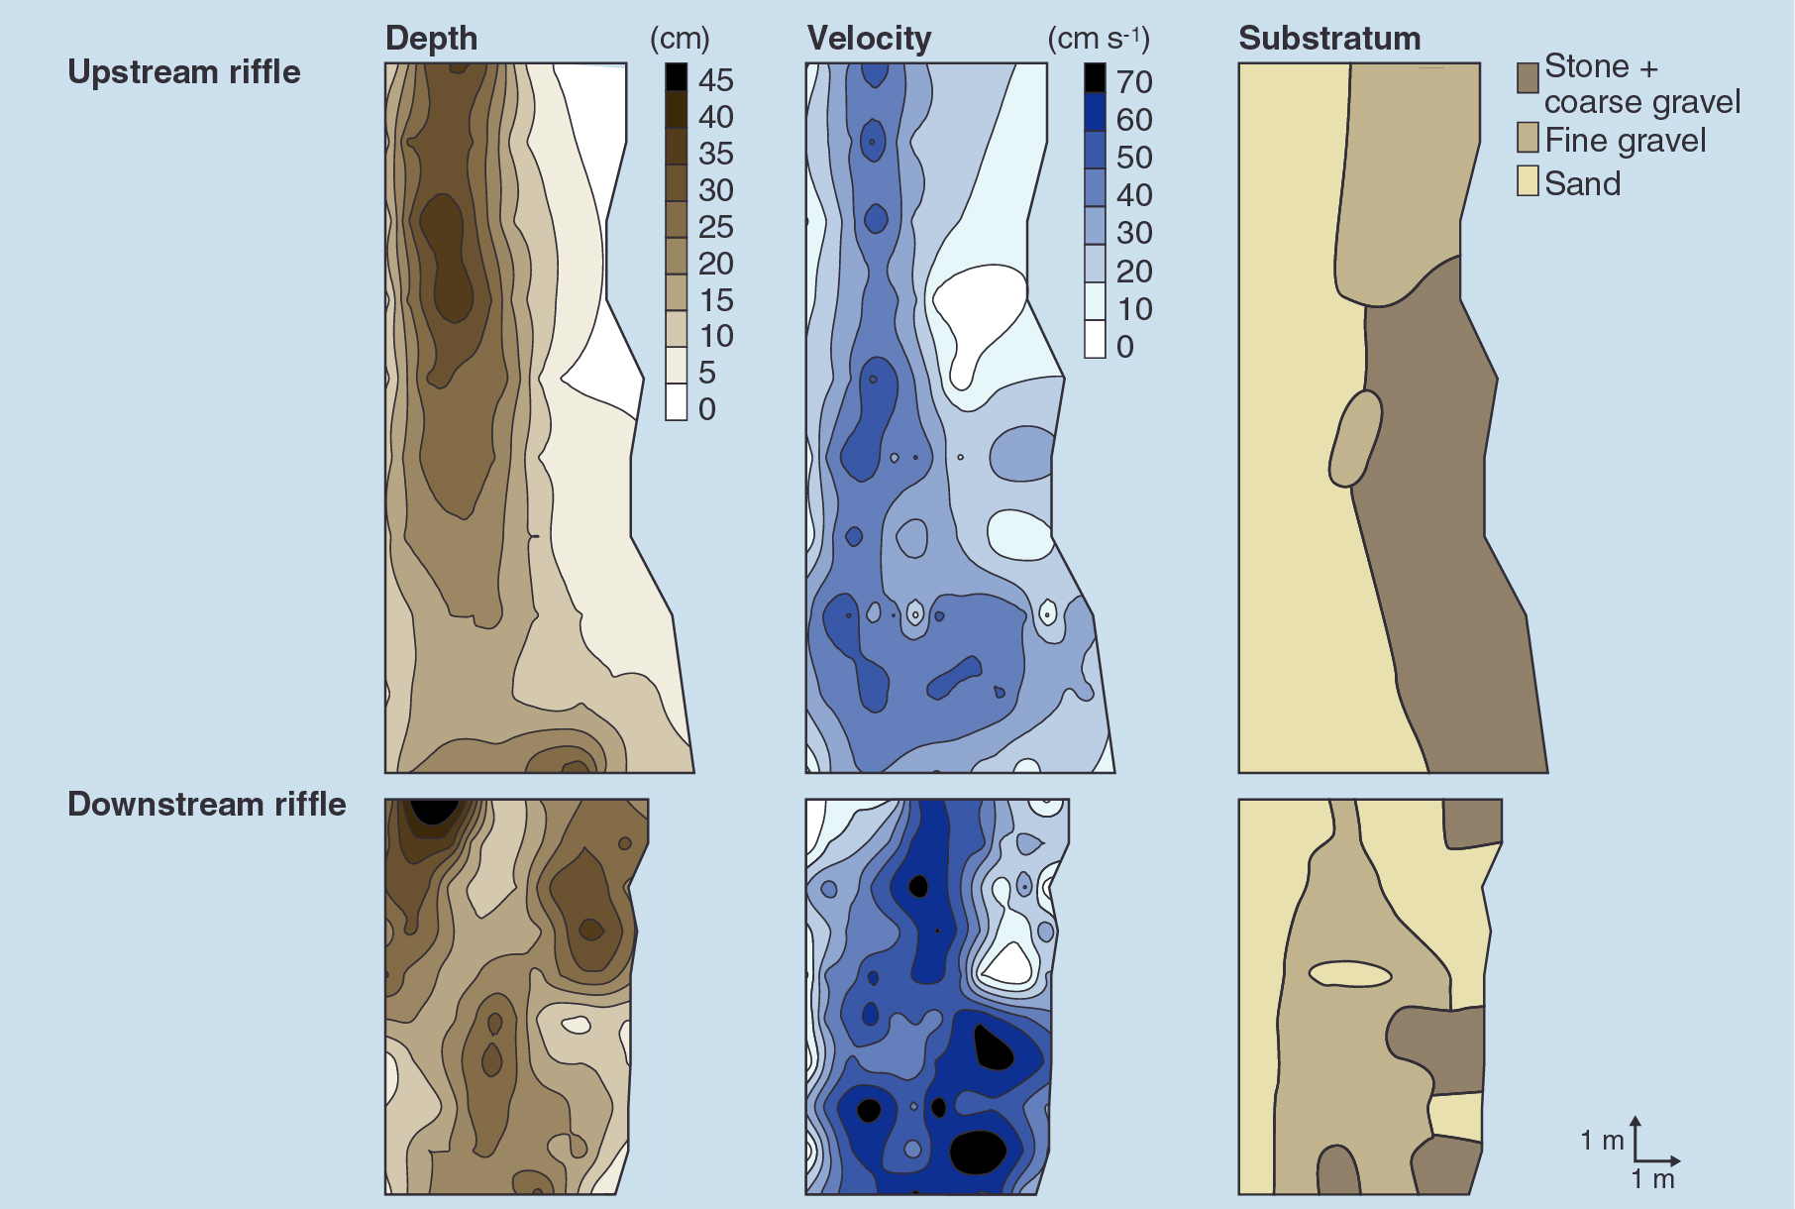
Spatial patterns: depth, current velocity and substratum
Notes:
Contour maps of depth, flow and substrates in the two riffles – at this level of detail with fine scaled grid measurements it was evident that they had some dissimilarities with regard to these features

Slide 20
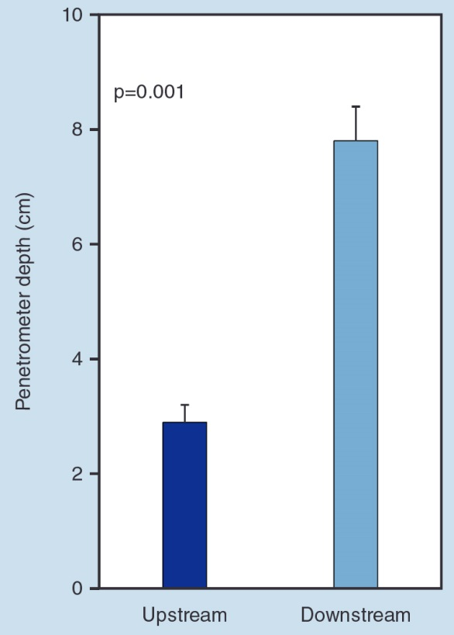
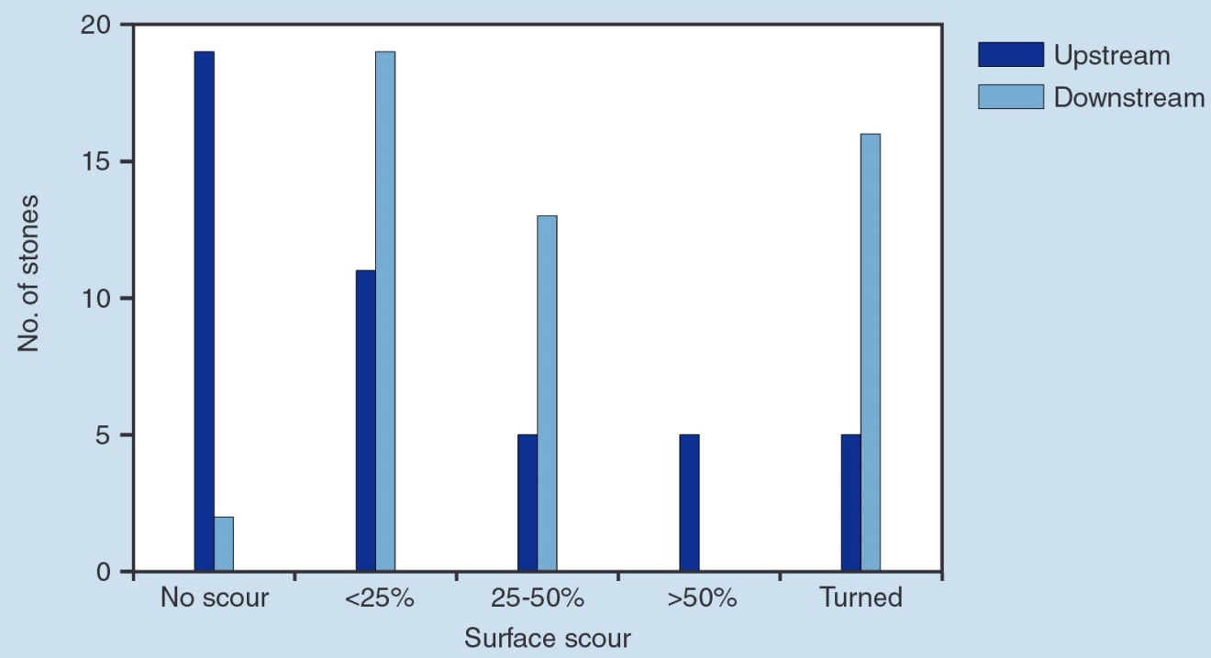
Stream bed stability - stones and penetrometer measurements
Notes:
However, when looking at the dynnamic it become very evident that the riffles were functionally very different. The upstream riffle were very compacted with little movement of substrate and poorly developed hyporheric zone

Slide 21
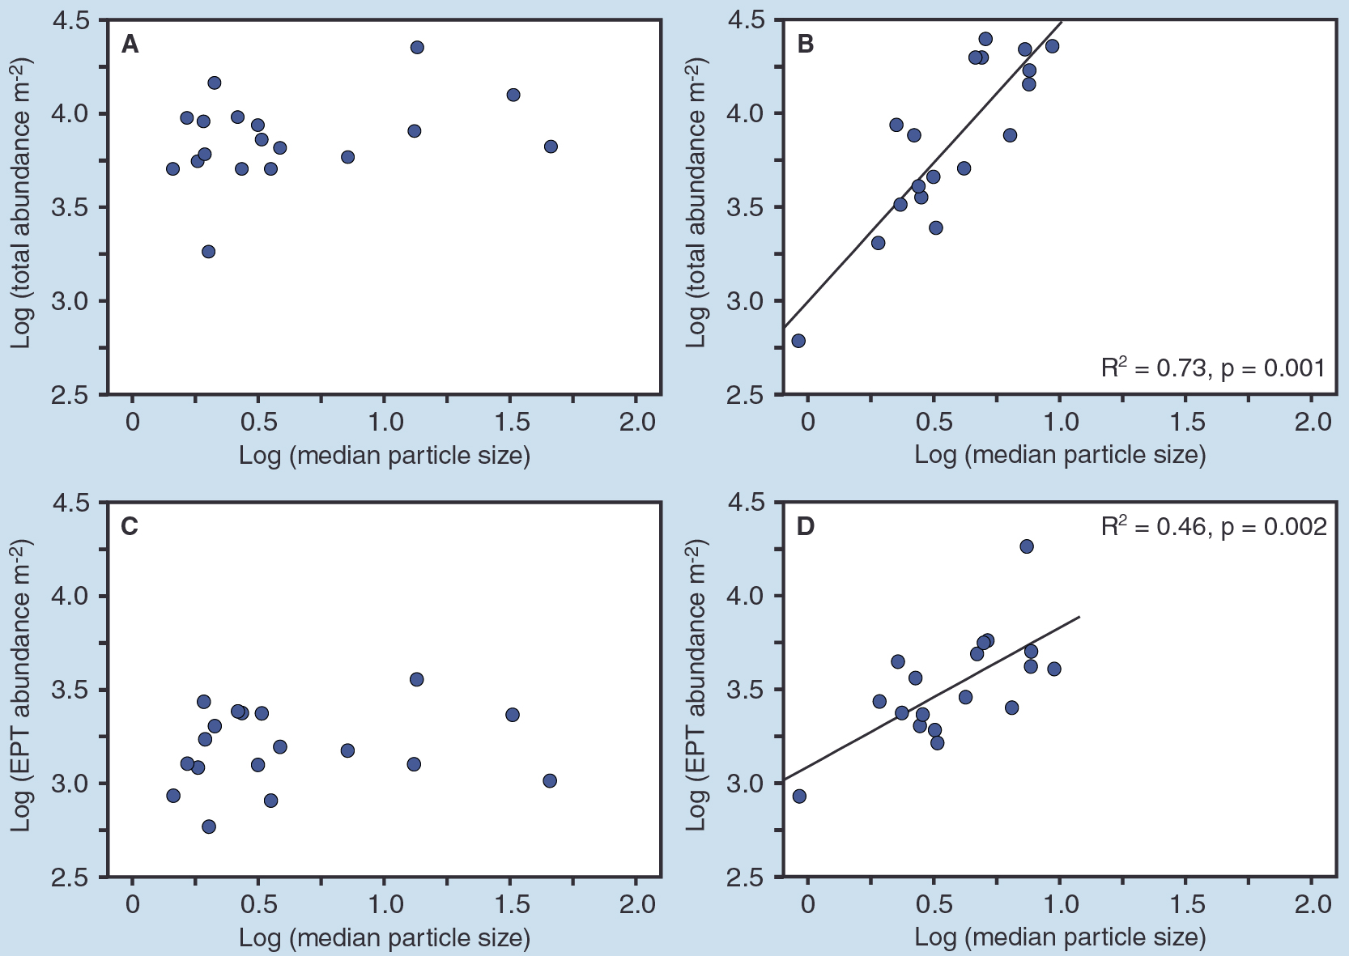
Macroinvertebrates – particle size
Upstream riffle
Downstream riffle
Notes:
This was reflected in the link between macroinvertebrate abundance (and EPT alone) where there was no relationship between particle size and numbers in the upstream as would be expected from other studies/theory. In contrast, the lower riffle was naturally functioning and showed the expected relationship

Slide 22
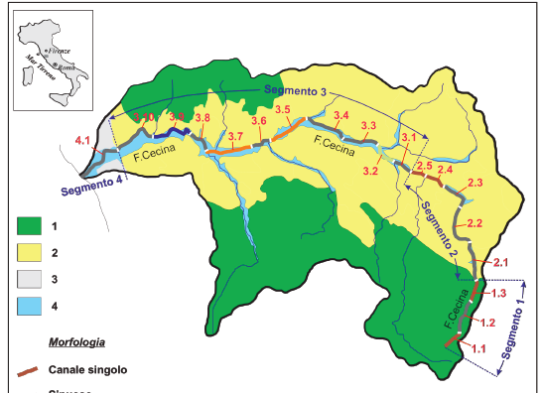
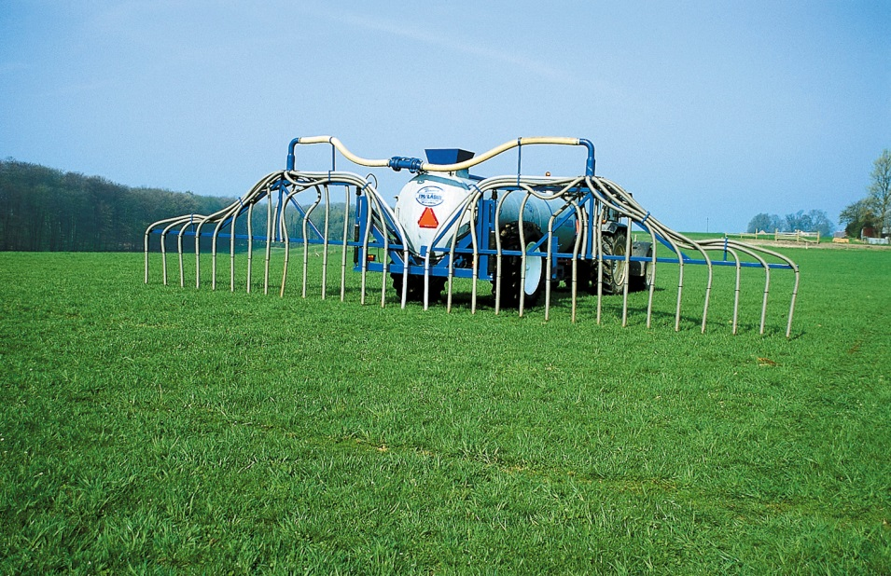
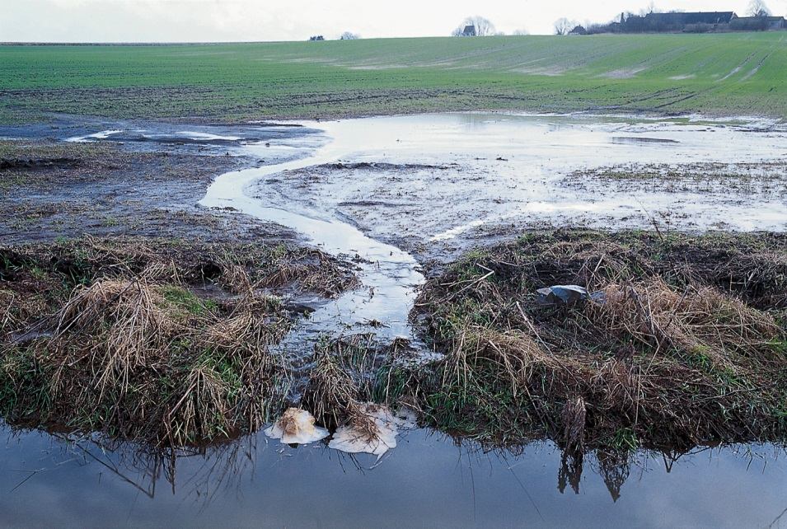
Catchment scale impacts: Upstream perturbations
Notes:
Reach scale restoration projects will be dependent on human pressures in the upstream catchment. Agri will influence nutrients, sediment dynamics and pesticide loads to down stream reaches as an example

Slide 23
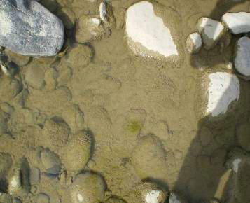
Clogging of sediment

Slide 24
Potential links
Loss of hyporheric zone (macroinverts, fish)
Low oxygen levels
(macroinverts)
Scouring at high flows
(perifyton)
Biotic interactions (realised habitat)

Slide 25
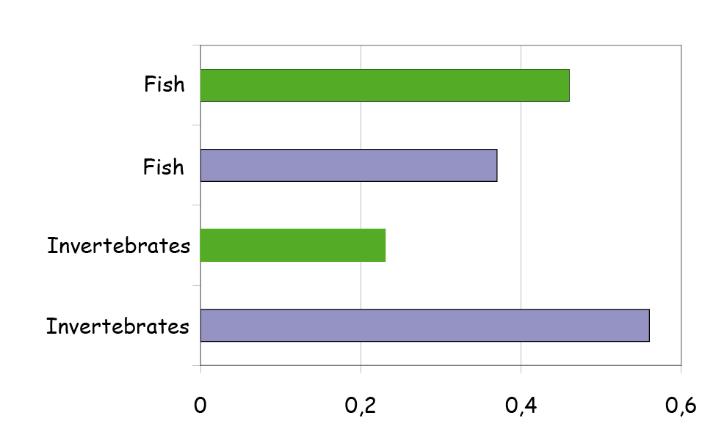
Acknowledge Ghosts of the past
- the temporal dimension
Abundance
50´s
Diversity
50´s
90´s
50´s
Harding et al. Proc Natl Acad Sci 95, 1998
Notes:
Past land use have in many cases a stronger influence on contemporary status than comtemporary stressors

Slide 26
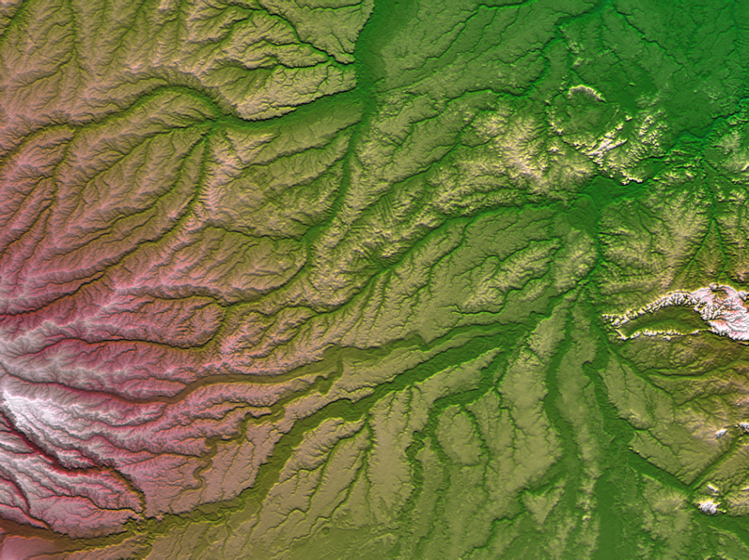
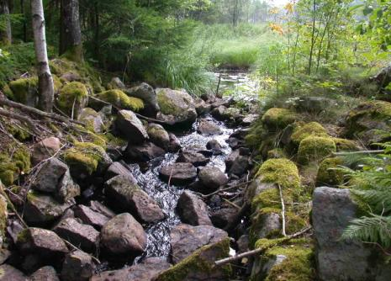
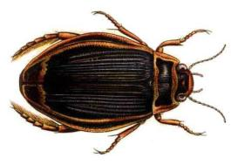
Dispersal
Habitats
Photo: NASA
Notes:
The ability of species to colonise restored reaches will be dependent of their dispersal abilities. Suitable habitats might be colonised if there are barriers – likewise unsuitable habitats might have a large number of species if ways of continued colonisastion is easy (mass effects in meta-community theory). Therefore, the direct link between composition of the biota and habitat filters will only occur when dispersal can occur but not at a rate that will mask the linkages

Slide 27
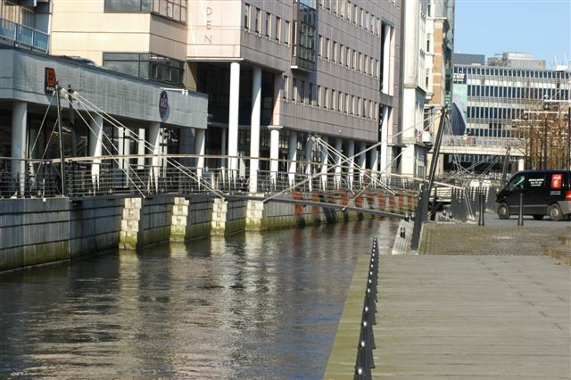
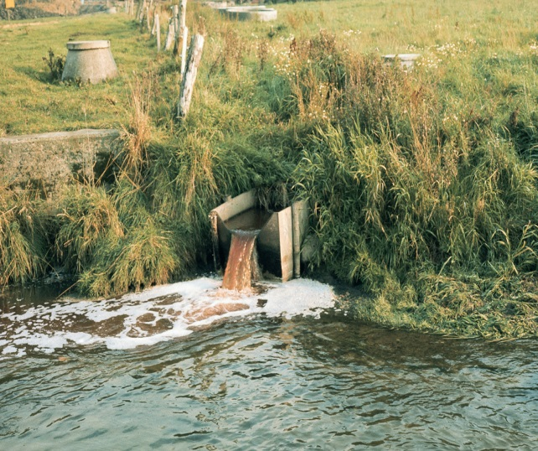
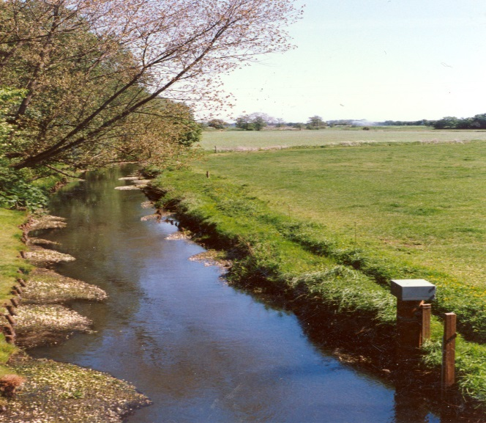

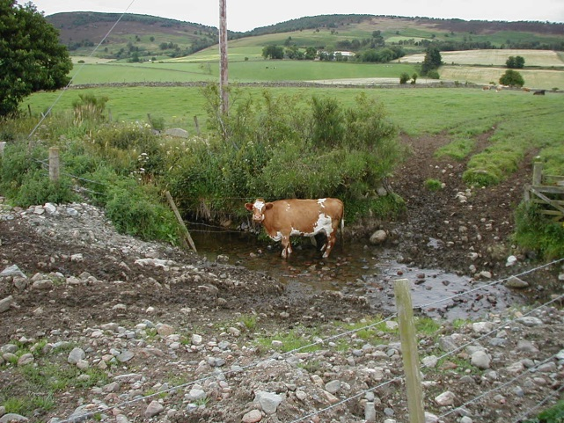
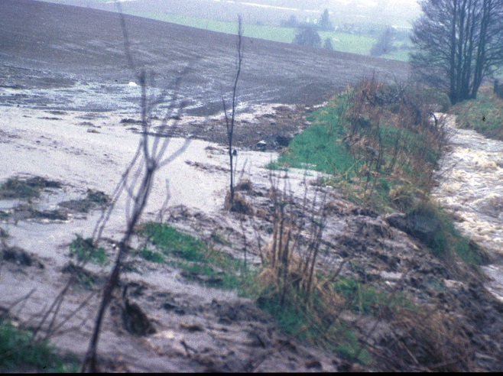
And multiple stress: a reality

Slide 28
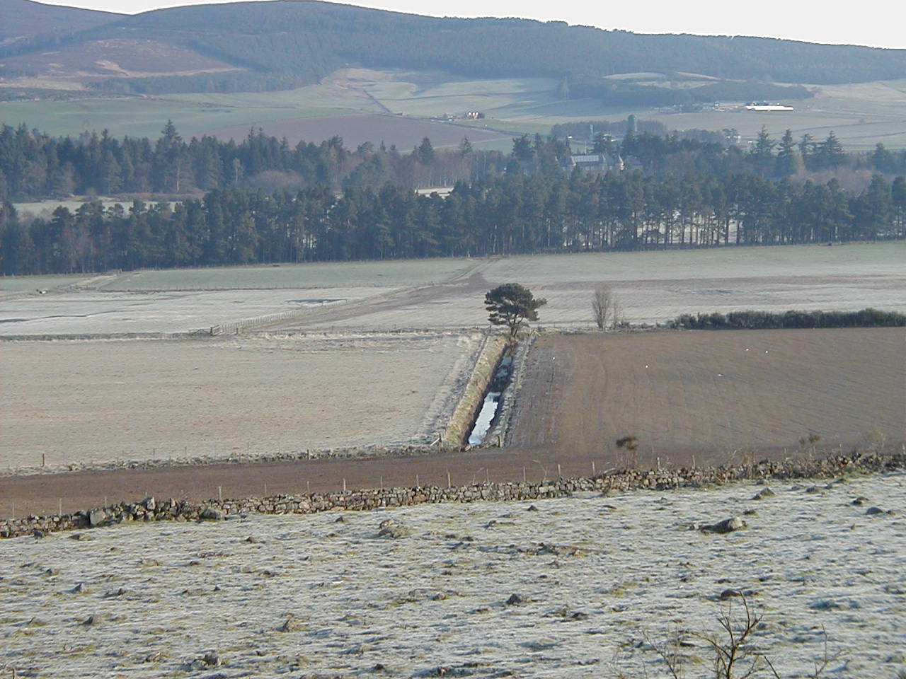
Multiple stressor scenarios – the rule, not the exception

Slide 29
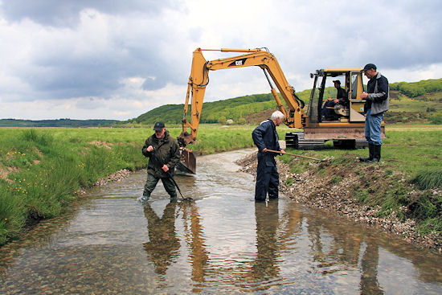
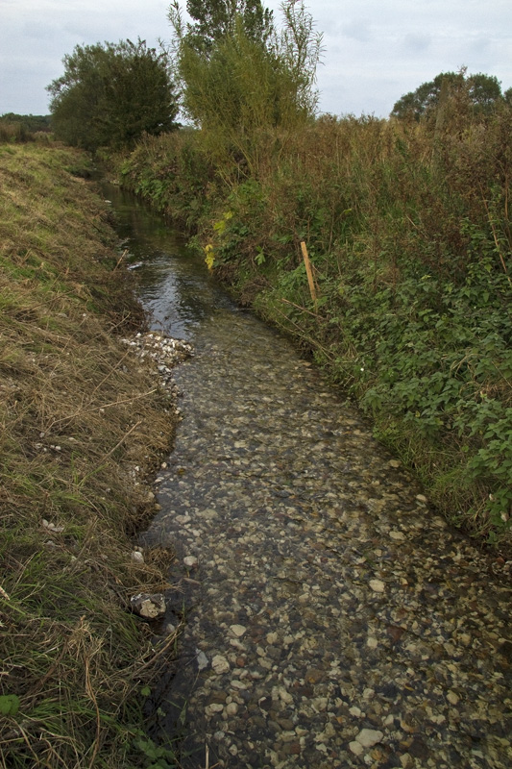
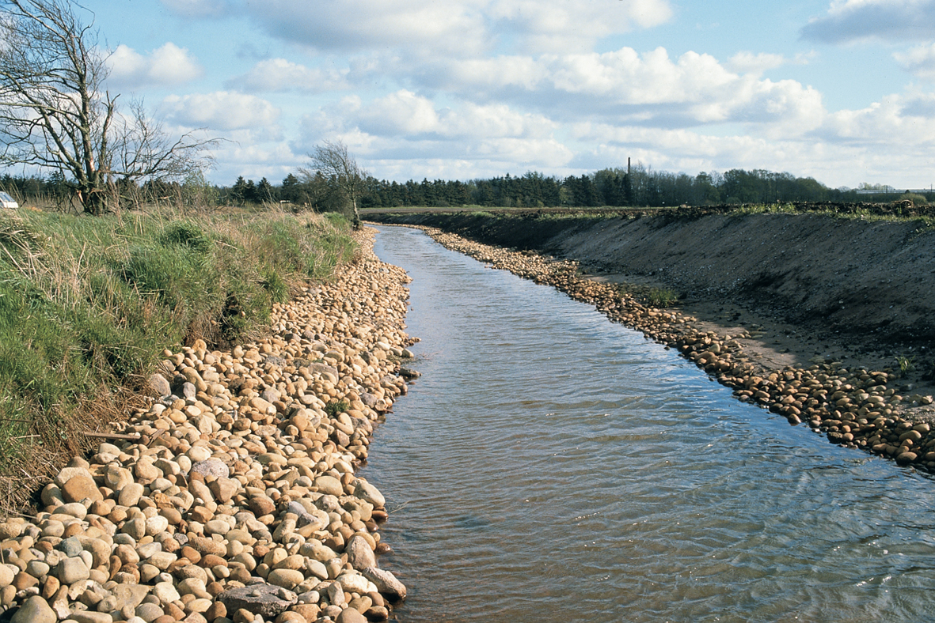
HYMO restorations ≠nature

Slide 30
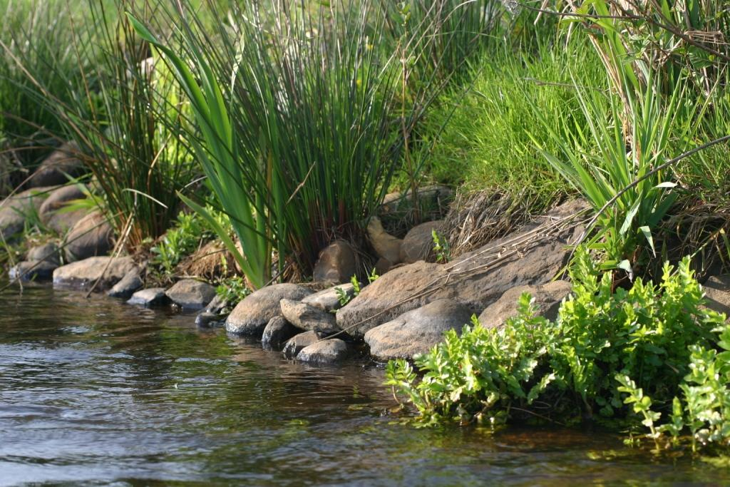
Not natural
Kristensen at al. 2011
Notes:
A study of the substrate of lowland streams showed that restored stream had significantly different substrate conditions to those of least impacted streams (reference) and streams that was still channedlised

Slide 31
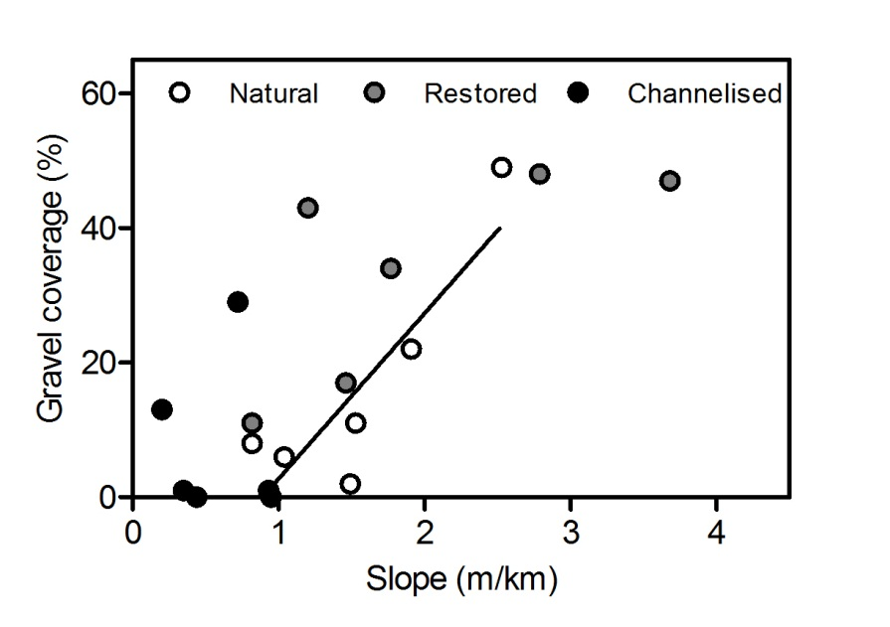
The laws of geomorphology are disobeyed
Pedersen, Kristensen & Friberg 2014

Slide 32
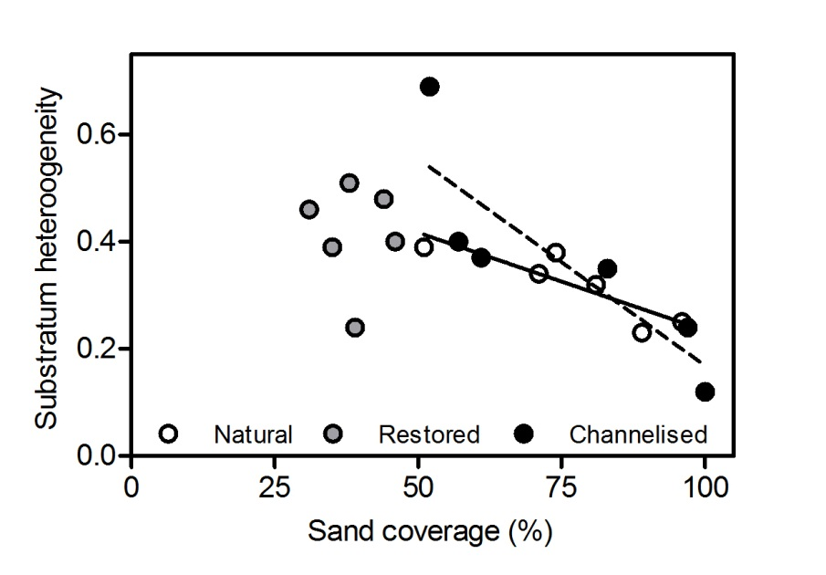
Sand is naturally the dominant substrate type in Danish lowland streams
Notes:
The restored reaches (light grey) have less sand and higher substratum heterogeneity than both reference and channelsied streams

Slide 33
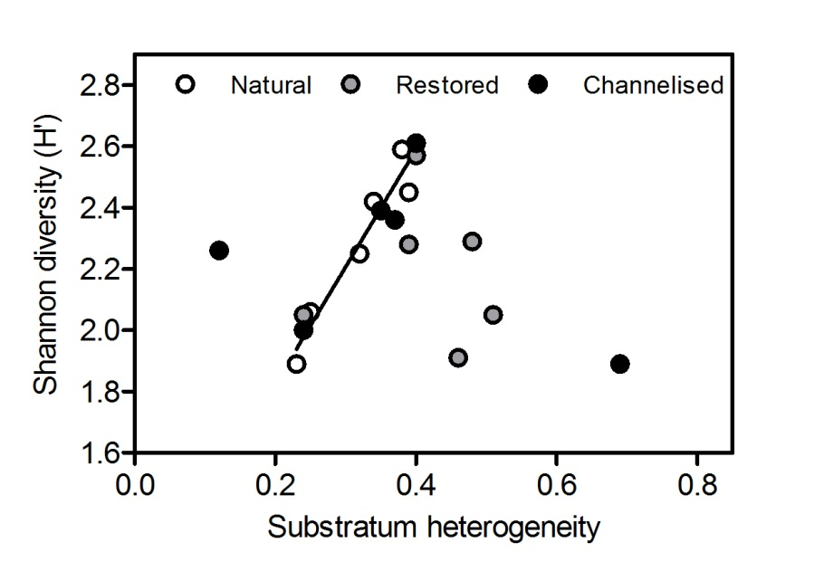
Substrate-invertebrate relationships disconnected
Notes:
The link between biodiversity as shannon-diversity and habitat heterogeneity follows the expected pattern in restored streams but not in the restored streams

Slide 34
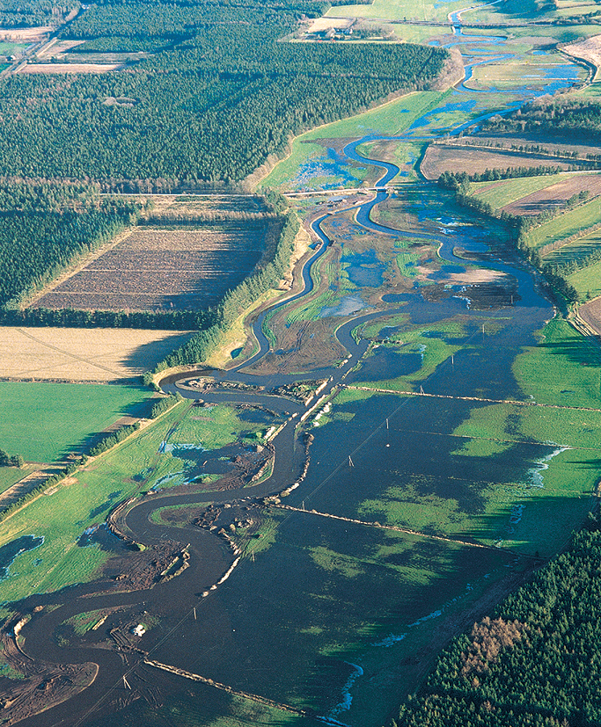
Good restoration projects go beyond the stream channel itself

Slide 35
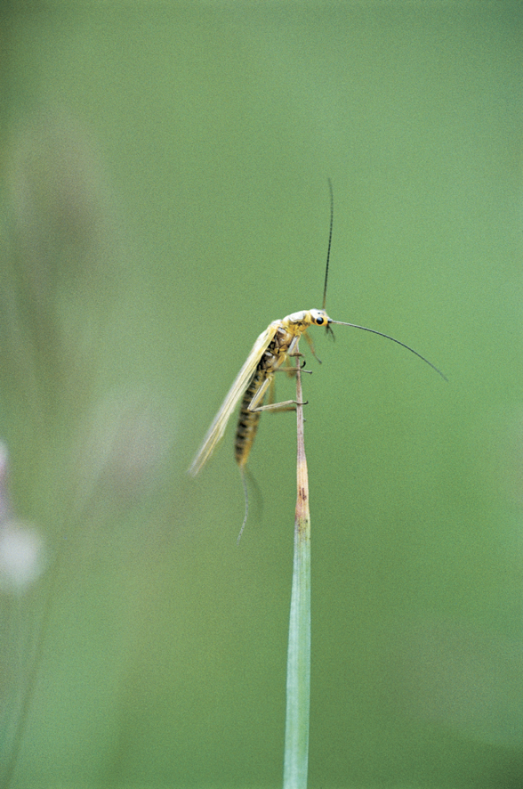
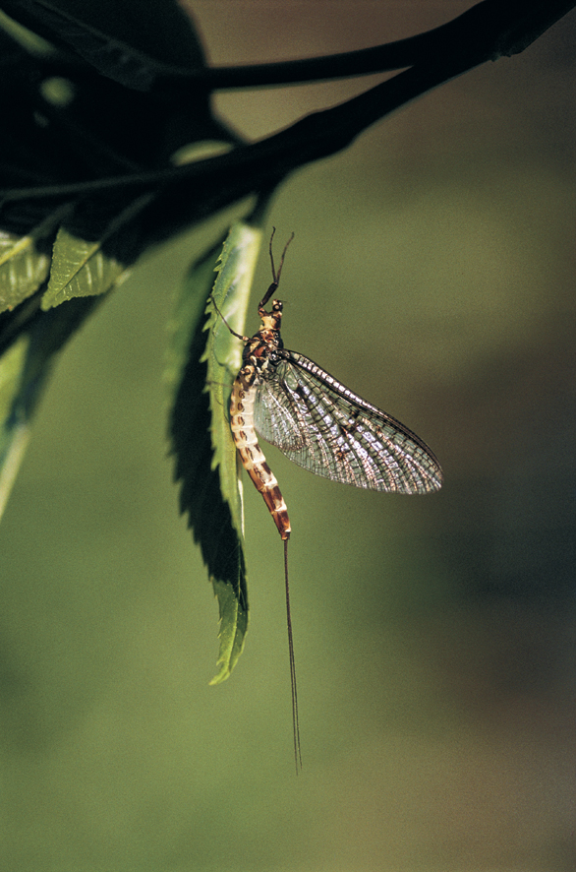
Adult aquatic insects
Isoperla
Ephemera
Notes:
Most of the invertebrates in lotic ecosystems are insects with terrestrial adult stages and therefore dependent on the terrestrial ecosystem. Similarily a number of plant species live in ecotone and fish species are using flooded riparian areas for spawning

Slide 36
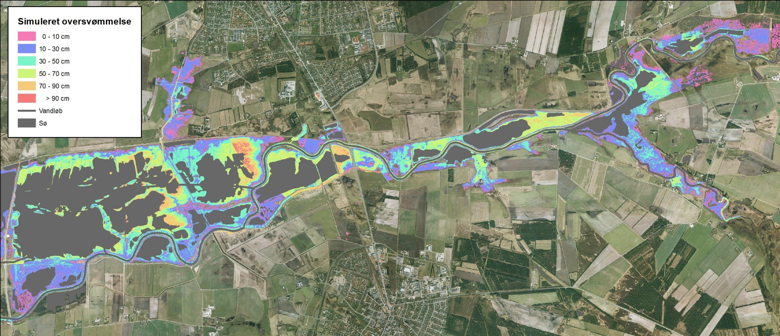
Modelled (MIKE-11) inundation of the floodplain at Q₁₀ for the period 2001-2011
Notes:
River Skjern – the restoration project involved reconnecting the flood plain with large areas being flooded

Slide 37
Possible indicators
Use of species traits: habitat template theory
Riparian organisms (ground beetles, amphibians)
Ecosystem functioning
Alternative sampling strategies incl. habitat/biotope mapping
Contempory and historic land-use at the catchment scale

Slide 38
The use of species traits
Closely related to habitat template
Less influenced by differences in biodiversity than identity based metrics
Contain directly information on linkages between hydromorphology and the biota
Link to aspects of ecosystem functioning

Slide 39
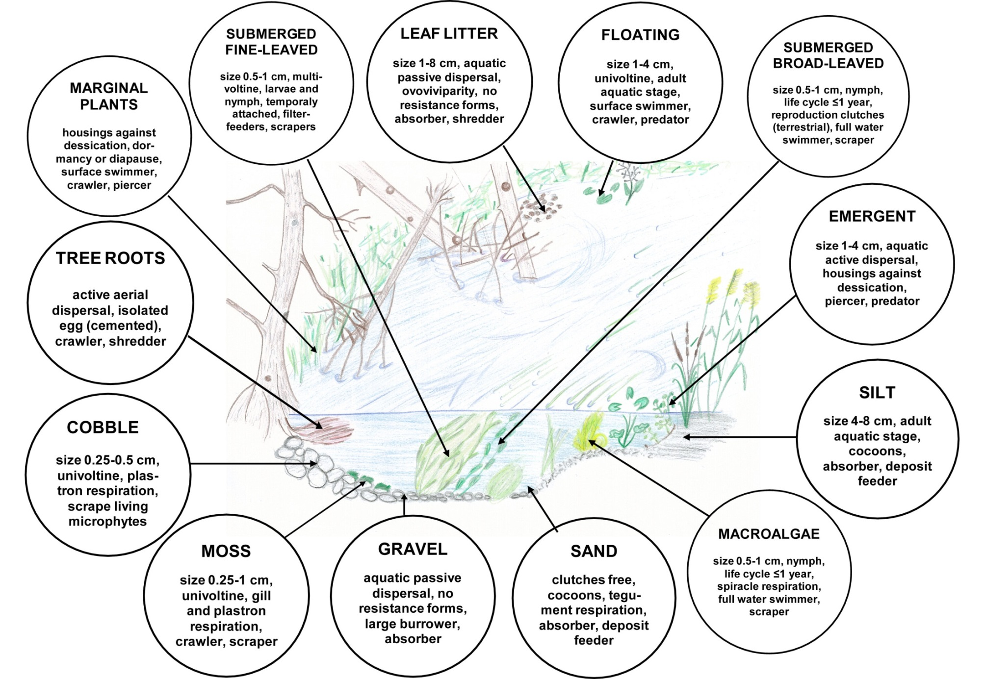
Demars et al. 2012
Notes:
Biotope specific trait composition of biotopes that were individually sampled in 8 UK rivers – clear differences in composition of traits in relation to biotope

Slide 40
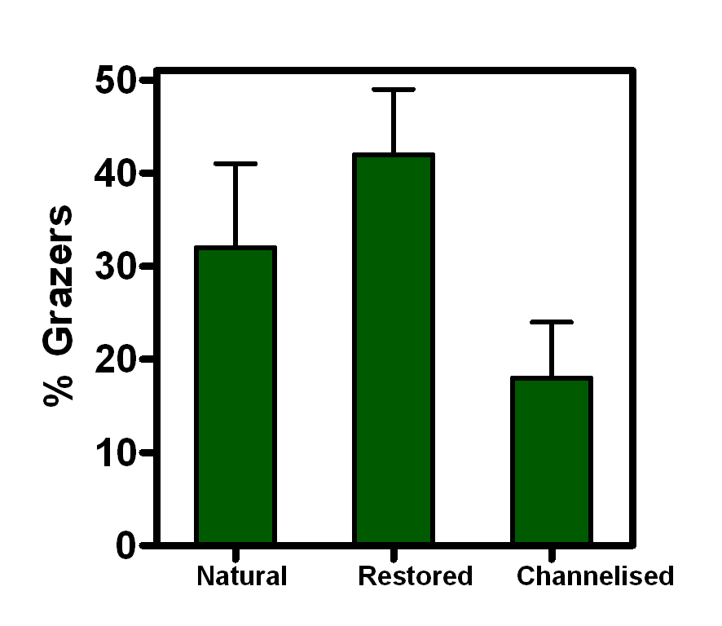
Functional response – feeding traits
Notes:
Clear trait response to restoration with grazers significantly more abundant in restored rivers. This can have implication for the food web and ecosystem functioning with higher grazing rates and maybe higher transfer of energy to top predators as fish.

Slide 41
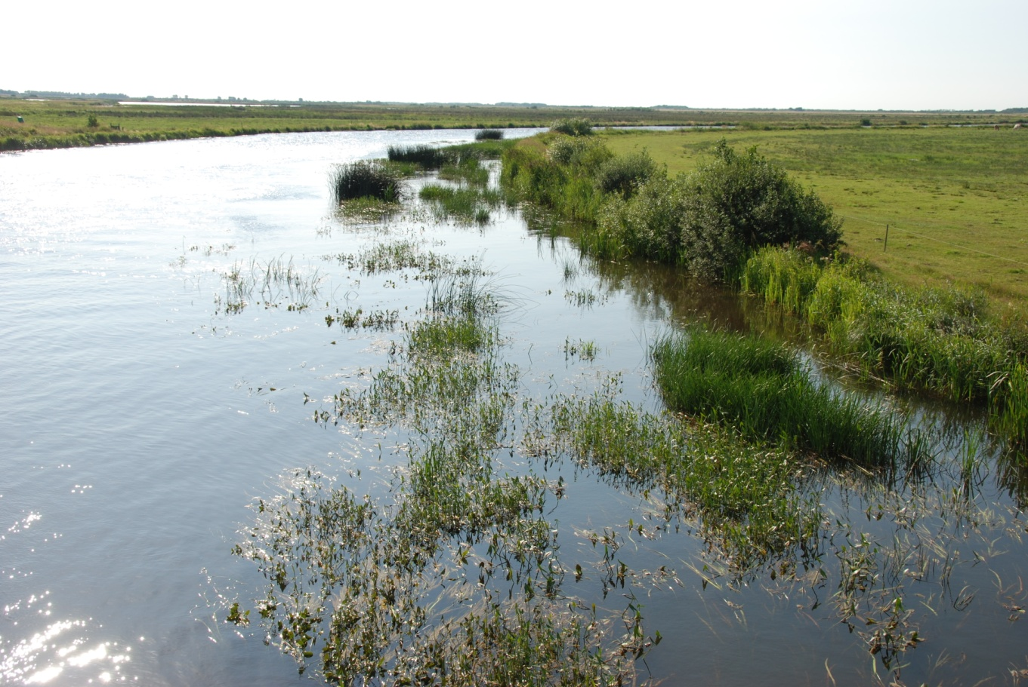
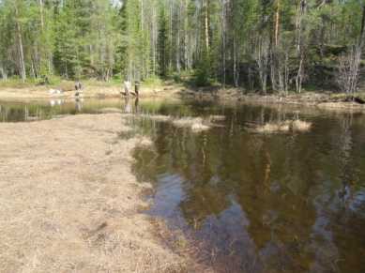
Rivers has many habitats – example: the restored river Skjernå
*especially negatively impacted by the regulation
run
Back waters*
Bank zone*
Edge
Notes:
Important to sample habitats/biotopes that are the ones changing – a lot of the in-stream habitats might be relatively little influenced by the restoration measures

Slide 42
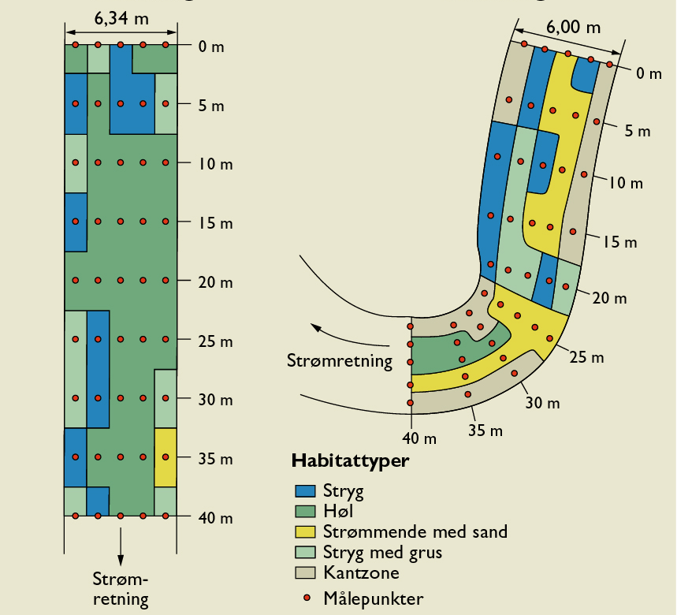
Habitat changes
Current
Habitats
Riffles
Pools
Glides
Gravel
Edge zone
Measurement points
Current
Notes:
Habitat mapping in the river Gels at an upstream control (i.e. not restored; still channelised) with that of the restored reach. It is evident that the pattern are different but also that most habitats are present in both although their frequence are different with particularily edge habitats being more frequent in the restored reach (more gentle slopes)

Slide 43
Conclusions
Many ecological reasons and human impacts explain why the linkage between HYMO and biota at the local scale is not clear-cut
Standard monitoring approaches are not very sensitive in detecting HYMO changes
To assess effectiveness of a HYMO restoration project we need a specifically designed monitoring strategy that includes:
  Robust statistical design
  Habitat/biotope specific sampling
  Quantification of the impact of confounding variables in time and space

